Slide 1


Rapid Exploration of Accelerator-rich Architectures:
Automation from Concept to Prototyping
David Brooks, Yu-Ting Chen, Jason Cong, Zhenman Fang, Brandon Reagen, Yakun Sophia Shao

Slide 2
Tutorial Outline
Time | Topic
9:00 am – 9:30 am | Introduction
9:30 am – 10:10 am | Standalone Accelerator Simulation: Aladdin
10:10 am – 10:30 am | Standalone Accelerator Generation: High-Level Synthesis
10:30 am – 11:00 am | HLS-Based Accelerator-Rich Architecture Simulation: PARADE
11:00 am – 11:30 am | Break
11:30 am – 12:00 pm | Pre-RTL SoC Simulation: gem5-Aladdin
12:00 pm – 12:30 pm | FPGA Prototyping: ARACompiler
12:30 pm – 2:00 pm | Lunch
2:00 pm – 3:00 pm | Panel on Accelerator Research
3:00 pm – 3:30 pm | Accelerator Benchmarks and Workload Characterization
3:30 pm – 4:00 pm | Break
4:00 pm – 5:00 pm | Hands-on Exercise
Notes:
Amortize optimization phase

Slide 3

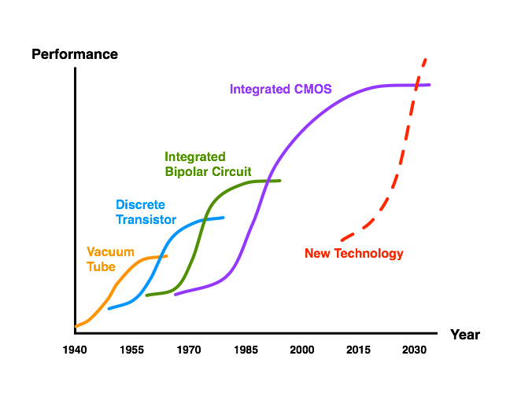
CMOS Technology Scaling

Slide 4
CMOS Technology Scaling
Technological
Fallow Period

Slide 5
…and it’s about time.
7nm, ~50B tx
Golden Age
Of Design
Technological
Fallow Period
[Colwell 2012]

Slide 6
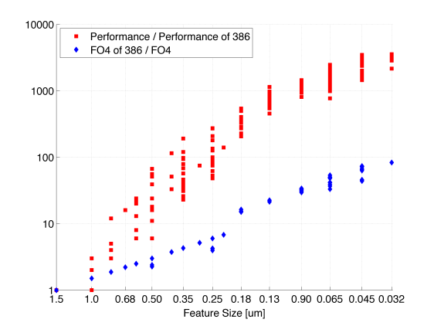
Technology Trends
Design
Technology
  Danowitz et al., CACM 04/2012, Figure 1

Slide 7
Potential for Specialized Architectures
16 | Encryption
17 | Hearing Aid
18 | FIR for disk read
19 | MPEG Encoder
20 | 802.11 Baseband
[Brodersen and Meng, 2002]
Notes:
Data is from isscc 1998-2002
One alternative is

Slide 8
Beyond Homogeneous Parallelism
Programmability
?
Composable
Accelerators
GPU
SIMD/ SSE
Energy
Efficiency
In Core
Out of Core
AESDEC
H.264
Fixed Function

Slide 9
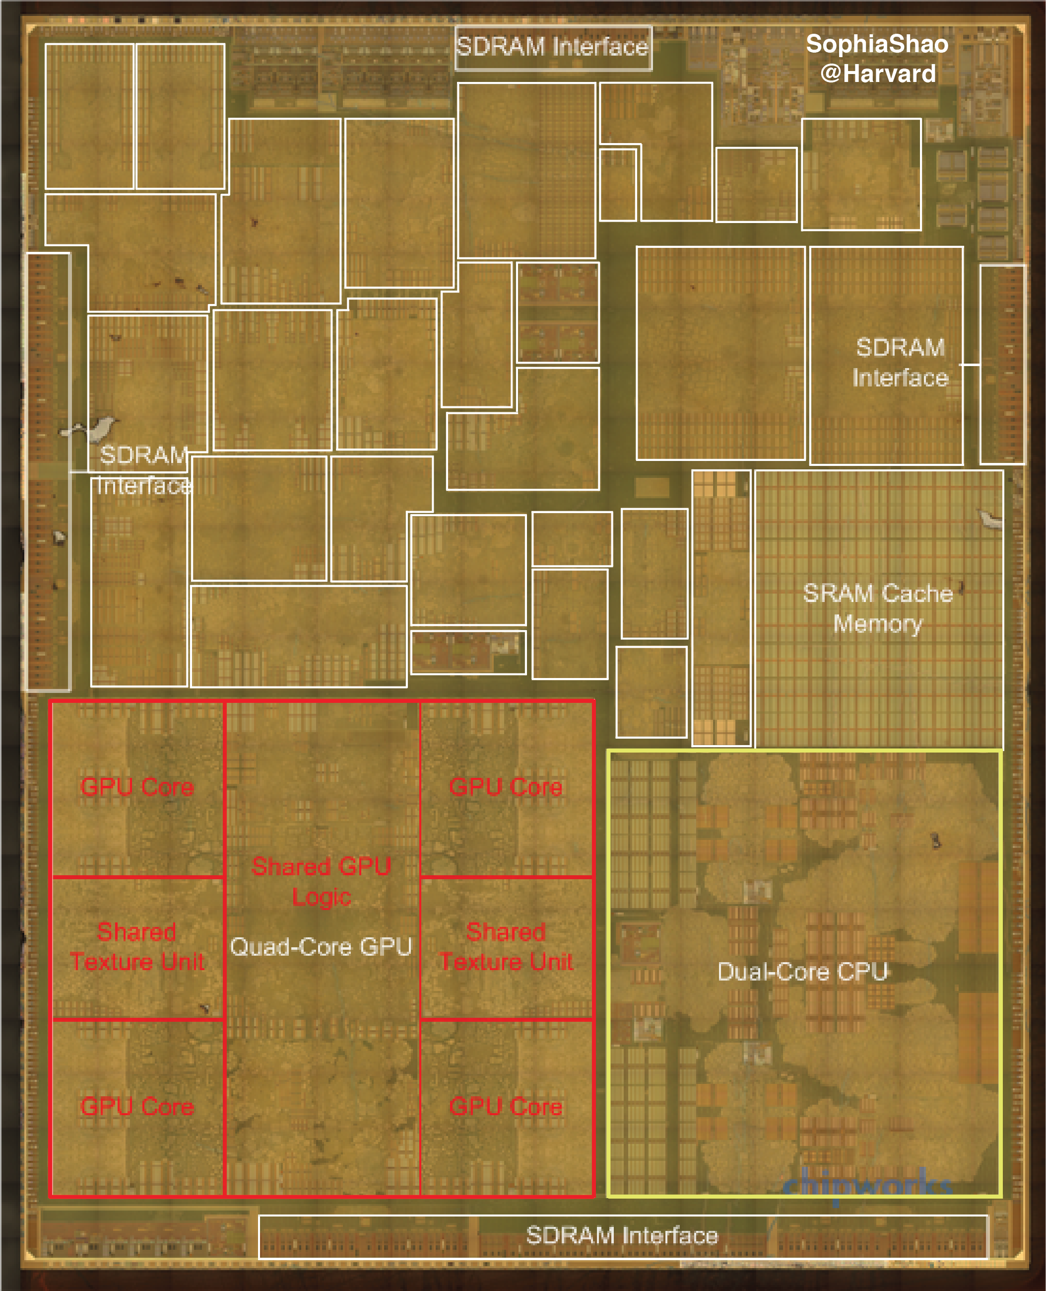
Cores, GPUs, and Accelerators:
Apple A8 SoC
Out-of-Core
Accelerators
[Die photo from Chipworks]
[Accelerators annotated by
Sophia Shao @ Harvard]
Notes:
[Die photo from Chipworks]
[Accelerators annotated by Sophia Shao @ Harvard]
www.anandtech.com/show/8562/chipworks-a8

Slide 10
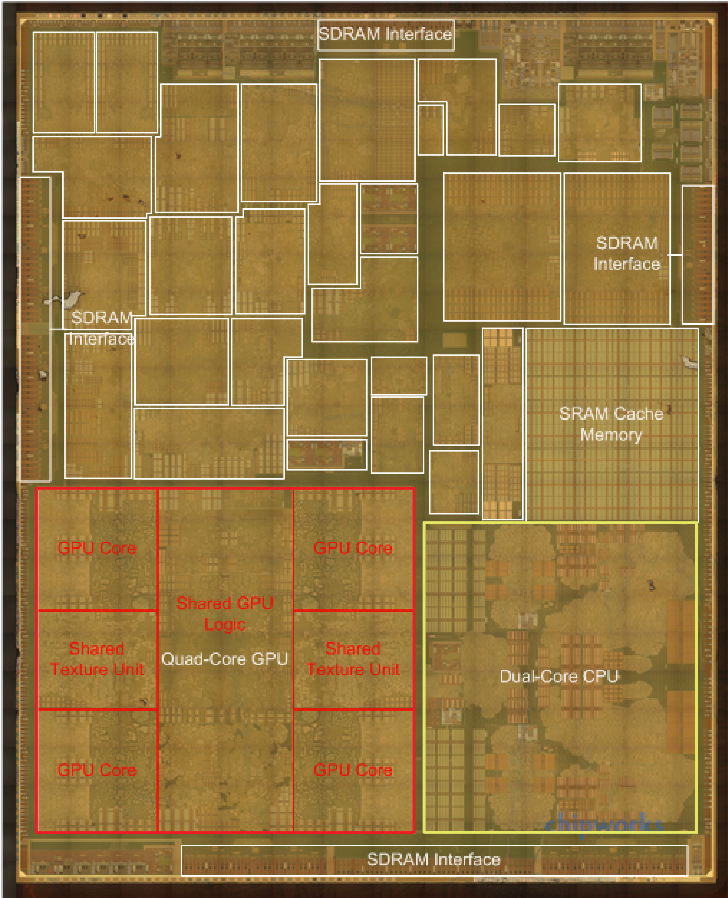
Cores, GPUs, and Accelerators:
Apple A8 SoC
Out-of-Core
Accelerators
Maltiel Consulting
estimates
Our estimates
[Y. Shao, IEEE Micro 2015]
[www.anandtech.com/show/8562/chipworks-a8]

Slide 11
Challenges in Accelerators
Flexibility
  Fixed-function accelerators are only designed for the target applications.
Design Cost
  Hand-written RTL implementation is inherently tedious and time-consuming.
Programmability
  Today’s accelerators are explicitly managed by programmers.

Slide 12
Composable Customization
Monolithic Hardware Accelerator

Slide 13
Composable Customization
Composed Accelerator with sub-blocks

Slide 14
Composable Customization
Composed Accelerator w/ Architectural Support
Shared Interconnect and Memory Fabric

Slide 15
Composable Customization
Composed Accelerator w/ Architectural Support
Shared Interconnect and Memory Fabric
Example:
“Accelerator Store”
Lyons et al. TACO’12

Slide 16
Composable Customization
Composed Accelerator w/ Architectural Support
Shared Interconnect and Memory Fabric

Slide 17
Composable Customization
Composed Accelerator w/ Architectural Support
Shared Interconnect and Memory Fabric
Composable Accelerators Provide Application Flexibility

Slide 18
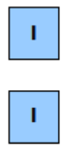
Composable Accelerators with Programmable Fabrics [ISLPED’2013]
Dynamic Resource Allocation of ABBs
Enhancement [ISLPED 2013]: with 20% of the chip area dedicated to programmable fabric, we can achieve more:
  Flexibility: An average 8.2x (up to 146x) speedup in other domains, such as commercial, vision and navigation
  Longevity: 22x speedup on a new application within the medical imaging domain

Slide 19
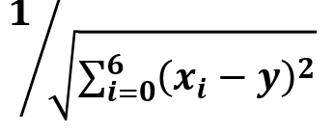

Composable Accelerators from Accelerator Building Blocks (ABBs)
Static Decomposition into ABBs
M
$2
$2
C
C
$2
$2
M
$2
$2
$2
C
Memory
C
$2
$2
$2
-
-
-
-
-
-
C
C
C
C
C
C
C
C
ABB1, Type = Poly
Input: Mem, Output: ABB2
Function: (x0-x1),(x2-x3),…
ABB: Poly1
A
A
A
A
A
A
A
*
*
*
*
*
*
A
A
A
GAM
A
A
A
A
ABB2, Type = Poly
Input: ABB1, Output: ABB3
Function: x0*x1+x2*x3+…
+
+
+
C
C
C
C
C
C
C
C
ABB: Poly2
+
Decomposed Denoise LCA
$2
$2
$2
C
C
$2
$2
$2
+
ABB3, Type = Sqrt
Input: ABB2, Output: ABB4
Function: sqrt(x0)
M
$2
$2
C
C
$2
$2
M
sqrt
ABB: Sqrt
C
Core
$2
L2 Banks
A
Accelerator + DMA + SPM
ABB4, Type = FInv
Input: ABB3, Output: Mem
Function: 1/x0
1/x
M
ABB: Finv
Memory controller
Router
Memory

Slide 20
Composable Accelerators [ISLPED’2012]
Dynamic Resource Allocation of ABBs
Cong, Ghodrat, Gill, Grigorian and Reinman. “CHARM: A Composable Heterogeneous Accelerator-Rich Microprocessor.” ISLPED 2012

Slide 21
Results
 |  | GPU (NVIDIA Tesla M2075) | FPGA (Xilinx V6) | Monolithic Accelerators | Composable Accelerators
Deblur | Performance | 97X | 25X | 58X | 107X
 | Energy | 19X | 130X | 369X | 261X
Denoise | Performance | 38X | 12X | 26X | 37X
 | Energy | 7.5X | 89X | 327X | 308X
Segmentation | Performance | 52X | 78X | 79X | 155X
 | Energy | 2.4X | 371X | 201X | 149X
Registration | Performance | 32X | 24X | 53X | 109X
 | Energy | 27.8X | 31X | 854X | 1102X
Average | Performance | 50X | 27X | 50X | 90X
 | Energy | 10X | 107X | 379X | 338X
Results relative to an Intel Core i7 (L5640 @ 2.27 GHz)
Accelerators are synthesized in 32nm technology
Enhancement [ISLPED’2013]: with 20% of the chip area dedicated to programmable fabric, we can achieve more:
  Flexibility: An average 12x (up to 146x) speedup in other domains, such as commercial, vision and navigation
  Longevity: 22x speedup on a new application within the medical imaging domain

Slide 22
Challenges in Accelerators
Flexibility
  Fixed-function accelerators are only designed for the target applications.
Programmability
  Today’s accelerators are explicitly managed by programmers.

Slide 23
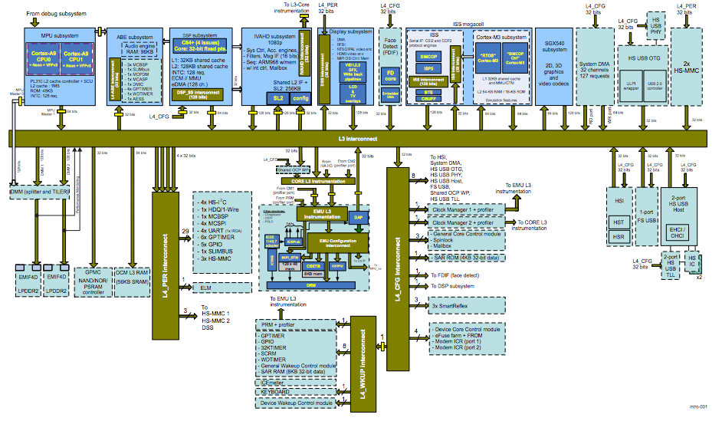
Today’s SoC
ARM Cores
Audio
DSP
Video
DSP
Face
Imaging
GPU
DMA
USB
SD
System Bus
USB
DMA
Secondary
Bus
Secondary
Bus
Tertiary
Bus
OMAP 4 SoC
http://www.anandtech.com/show/4551/motorola-droid-3-review-third-times-a-charm/10

Slide 24
Challenges in Accelerators
Flexibility
  Fixed-function accelerators are only designed for the target applications.
Programmability
  Today’s accelerators are explicitly managed by programmers.
Design Cost
  Accelerator (and RTL) implementation is inherently tedious and time-consuming.

Slide 25
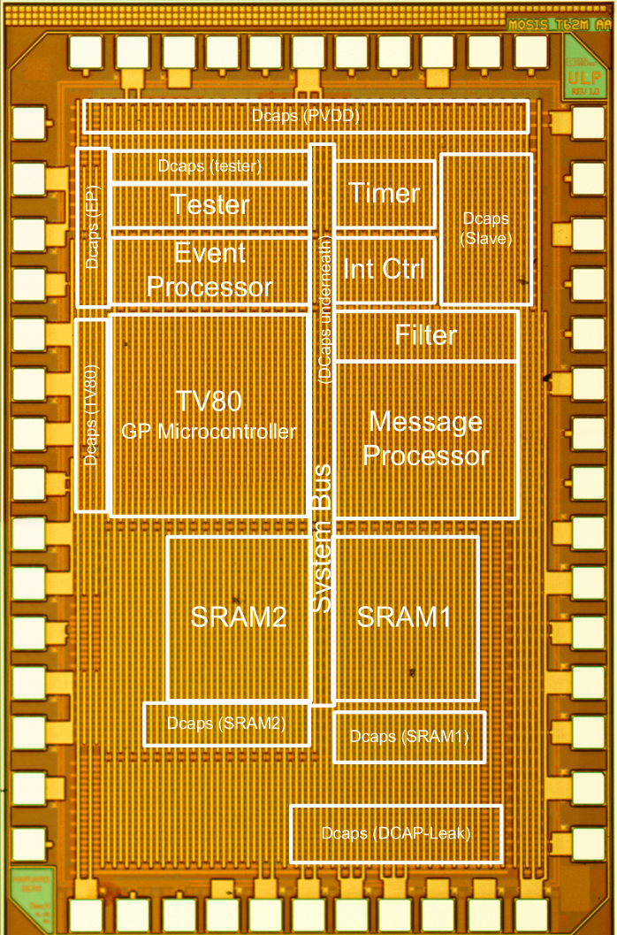
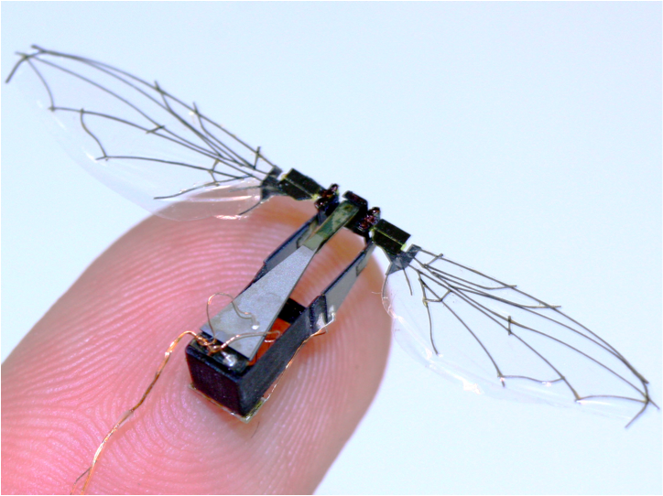
Some highlights (and pain points) of our research in accelerator architectures
Event-Driven Architectures
For Wireless Sensor Nodes
Accelerator Memory
Systems Design:
“Accelerator Store”
Robobee “Brain”
System-on-Chip
Accel
Core
Accel
Core
Accel
Core
Accel
Core
Accel
Store
Accel
Store
Accel
Core
Accel
Core
Accel
Core
Accel
Core
Accel
Core
Accel
Core
Accel
Core
Accel
Core
Accel
Store
Accel
Store
AS OCN
Accel
Core
Accel
Core
Accel
Core
Accel
Core
Hempstead, ISCA’05
Lyons, CAL’10
Zhang, CICC’13, VLSI’15

Slide 26
Accelerator Research Infrastructure
Standalone
System Integration
Modeling
Aladdin
gem5-Aladdin
High-Level Synthesis
PARADE
RTL
Prototyping
ASIC Flow or FPGA Prototype

Slide 27
Panel: Rapid Exploration of
Accelerator-Rich Architectures
Organizer: David Brooks (Harvard) and Jason Cong (UCLA)
Moderator: Jason Cong
Panelists:
Ameen Akel (Micron)
Chris Batten (Cornell)
Derek Chiou (UT-Austin/Microsoft)
Boris Ginzburg (Intel)
Michael Kishinevsky (Intel)
Notes:
27

Slide 28
Questions to the Panel (and attendees)
What accelerators have you designed or plan to design?
What is the process to select the workloads or kernels for acceleration?
How do you estimate the acceleration potential?
What’s your methodology for accelerator design? E.g.
  How do you select the communication scheme between the CPU and the accelerators?
  Do you do design space exploration?
  How do you trade-off efficiency and flexibility in accelerator designs?
How do you validate your accelerator design, in terms of both performance and correctness?

Slide 29
Tutorial Outline
Time | Topic
9:00 am – 9:30 am | Introduction
9:30 am – 10:10 am | Standalone Accelerator Simulation: Aladdin
10:10 am – 10:30 am | Standalone Accelerator Generation: High-Level Synthesis
10:30 am – 11:00 am | HLS-Based Accelerator-Rich Architecture Simulation: PARADE
11:00 am – 11:30 am | Break
11:30 am – 12:00 pm | Pre-RTL SoC Simulation: gem5-Aladdin
12:00 pm – 12:30 pm | FPGA Prototyping: ARACompiler
12:30 pm – 2:00 pm | Lunch
2:00 pm – 3:00 pm | Panel on Accelerator Research
3:00 pm – 3:30 pm | Accelerator Benchmarks and Workload Characterization
3:30 pm – 4:00 pm | Break
4:00 pm – 5:00 pm | Hands-on Exercise
Notes:
Amortize optimization phase

