Slide 1
The High-Level Synthesis approach to accelerator design
ISCA 2015
Jason Cong and Brandon Reagen

Slide 2
High-Level Synthesis: A Brief History
Early attempts
  Research projects
  1980s ~ early 1990s
Rise and fall of early commercialization
  Tools from major EDA vendors
  1990s~early 2000s
Renewed interests
  Start-ups, followed by major EDA vendors
  Mid 2000 ~ present
Wide adoption by the FPGA design community
  Led by Xilinx Vivado HLS (based on AutoESL acquisition in 2011)
  2012 ~ present

Slide 3
C/C++ to FPGA Synthesis xPilot (UCLA) -> AutoPilot (AutoESL) -> Vivado HLS (Xilinx)
Design Specification
C/C++/SystemC
User Constraints
Platform-based C to RTL synthesis
Synthesize pure ANSI-C and C++, GCC-compatible compilation flow
Full support of IEEE-754 floating point data types & operations
Efficiently handle bit-accurate fixed-point arithmetic
SDC-based scheduling
Automatic memory partitioning
…
QoR matches or exceeds manual RTL for many designs
Common Testbench
AutoPilotTM
Simulation, Verification, and Prototyping
Compilation &
Elaboration
ESL Synthesis
IR Transformation &
Optimizations
Behavioral & Communication
Synthesis and Optimizations
Platform
Characterization
Library
=
RTL HDLs &
RTL SystemC
Timing/Power/Layout
Constraints
FPGAs (or ASICs)
Developed by AutoESL, acquired by Xilinx in Jan. 2011

Slide 4
AutoPilot Results: Sphere Decoder (from Xilinx)
Wireless MIMO Sphere Decoder
  ~4000 lines of C code
  Xilinx Virtex-5 at 225MHz
Compared to optimized IP
  11-31% better resource usage
Metric | RTL Expert | AutoPilot Expert | Diff (%)
LUTs | 32,708 | 29,060 | -11%
Registers | 44,885 | 31,000 | -31%
DSP48s | 225 | 201 | -11%
BRAMs | 128 | 99 | -26%
TCAD April 2011 (keynote paper)
“High-Level Synthesis for FPGAs: From Prototyping to Deployment”
Notes:
4

Slide 5


AutoPilot Results: Optical Flow (from BDTI)
Application
  Optical flow, 1280x720 progress scan
  Design too complex for an RTL team
Compared to high-end DSP:
  30X higher throughput, 40X better cost/fps
Input Video
Output Video
 | Chip Unit Cost | Highest Frame Rate @ 720p (fps) | Cost/performance ($/frame/second)
Xilinx Spartan3ADSP XC3SD3400A chip | $27 | 183 | $0.14
Texas Instruments TMS320DM6437 DSP processor | $21 | 5.1 | $4.20
BDTi evaluation of AutoPilot http://www.bdti.com/articles/AutoPilot.pdf
Notes:
5

Slide 6
What Made xPilot/AutoPilot Successful
Use of LLVM compilation infrastructure
  A good decision made in 2004
Platform-based synthesis
  RTLs are optimized for different implementation platforms
    Cell and interconnect delays, memory configurations, I/O ports/types …
Most importantly, algorithmic innovations
  Global optimization under multiple constraints, objectives, e.g.
    SDC based scheduling
    Use of soft constraints and behavior-level don’t-cares
    Automatic memory partitioning
    Simultaneous register and FU binding …
  Result: competitive to manual RTL designs

Slide 7

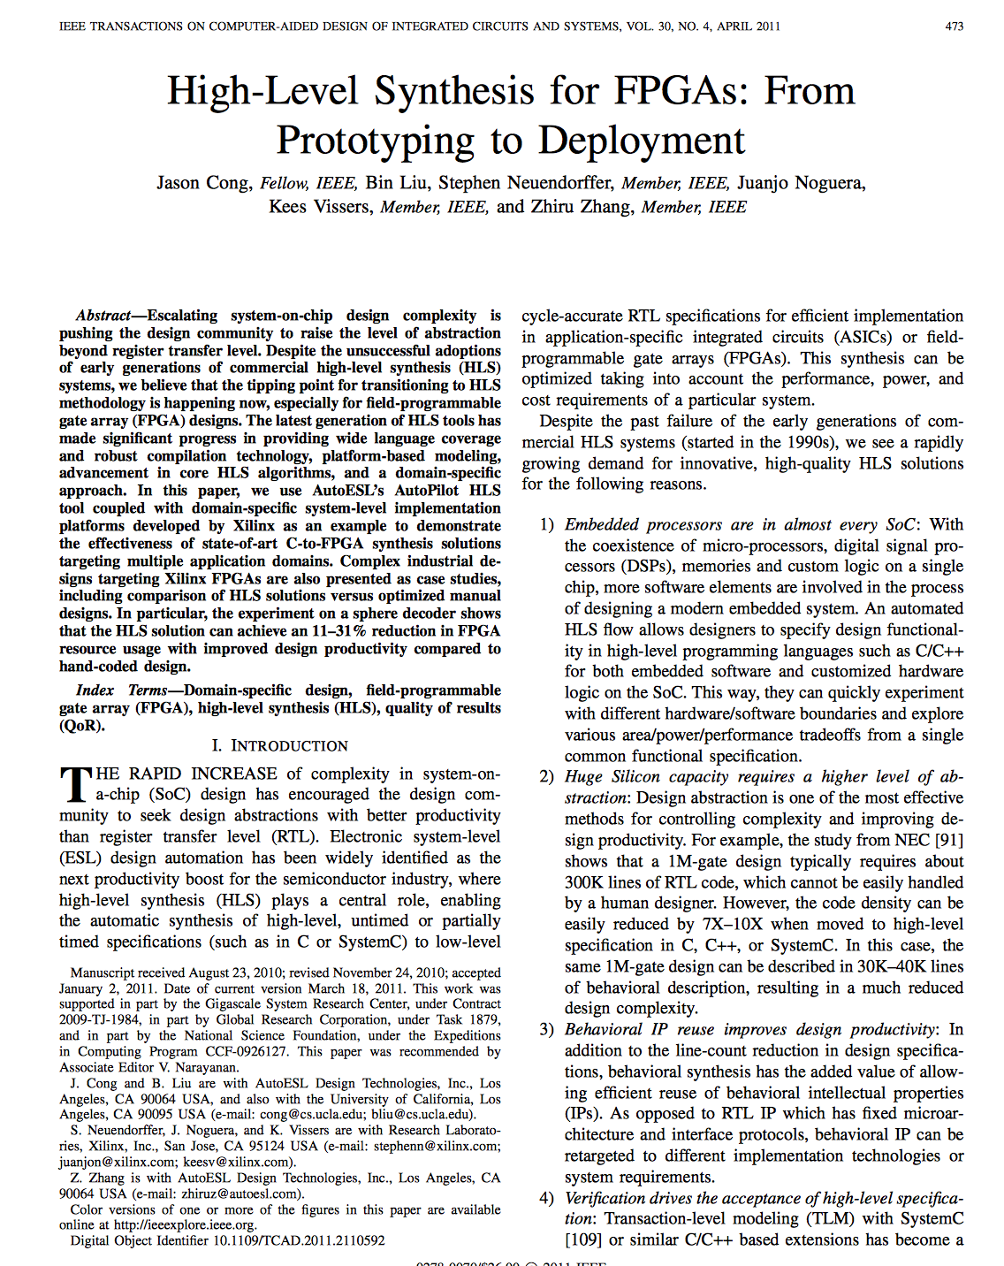
Learn More about AutoESL/AutoPilot
Book chapter, Springer 2008
IEEE T-CAD April 2011 Keynote Paper

Slide 8
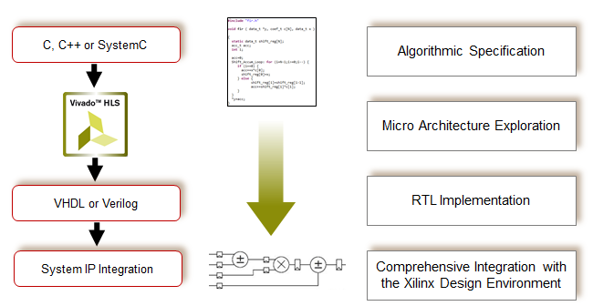
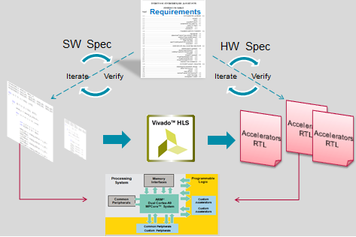
Continued Success at Xilinx (after 2011 acquisiton):
Vivado High-Level Synthesis (HLS) for Hardware IP Creation
Accelerate Algorithmic C to IP Integration
Accelerate Algorithmic C to Co-Processing Accelerator Integration
Used in over 3,000+ companies
  Adopted across broad base of applications and markets
  Proven on real customer designs
  Clear differentiator for accelerating design productivity
Notes:
Time on foil: 2 mins
Speaker Notes: Goal is to talk about the applicability and success of Vivado High-Level Synthesis
Vivado HLS allows users to code in C, C++ and SystemC by enabling algorithmic, data type and interface abstraction at the higher level of design specification. HLS enables designers to focus on algorithmic specification of their designs using application specific C, C++ or SystemC data types and constructs while abstracting the designer from worrying about mapping top level interface to streaming AXI4-Stream interfaces or memory mapped AXI4-Lite and AXI4 interface.
Over 400 active users and 1000+ evaluation users are leveraging Vivado High-Level Synthesis (HLS) to create IP for Xilinx All Programmable devices from their C, C++ or SystemC specifications. Vivado HLS is being used across a broad base of applications and markets. Some examples of applications implemented using Vivado HLS are:
Wirelesss LTE switch: Our customers software engineers were able to convert DSP algorithms written in C into FPGA RTL within weeks, proving possible to replace TI DSP with Xilinx Zynq device.
Video codecs: Vivado HLS allowed AVB customers to capture this aggressive market by speeding algorithm development while allowing for maximum flexibility of features and product development
Automotive TV tuner: Our customer was able to modify the SW running on Zynq and added some working HLS threads for the DVB-T transport streams. This resulted in helping them reduce the Zynq CPU-load from 80% to 2-3%
Industrial networking UPS control: For a UPS control board on an industrial networking application all DSP filters (40% of the PL) had been developed using Vivado HLS. This helped our customers to speed up the design of those blocks by 3x to 4x

Slide 9
C to Verified RTL from Months to Weeks
“In an HDL design, each scenario would likely cost an additional day of writing code …
With Vivado HLS these changes took minutes”
Nathan Jachimiec, R&D Engineer, Agilent Technologies
Radar Design 1024 x 64 QRD Floating-Point data path | Conventional Hand-coded HDL Approach | Using Vivado High Level Synthesis
Design Language | VHDL (RTL) | C
Design Time (weeks) | 12 | 1
Latency (ms) | 37 | 21
Memory (RAMB18E1) | 134 (16%) | 10 (1%)
Memory (RAMB36E1) | 273 (65%) | 138 (33%)
Registers | 29686 (9%) | 14263 (4%)
LUTs | 28152 (18%) | 24257 (16%)
“I was able to design complex linear algebra algorithms
10x faster than before with VHDL, and yet achieved
better QoR with Vivado HLS.“
Design Engineer, Major A&D contractor
“..we always use C to quickly build a system-level model for validation of key algorithms.. problem .. quickly and efficiently convert C into a HDL”.
“With Xilinx Vivado HLS, …. … used C to implement a key algorithm … into Verilog. We verified both the functionality and performance in Xilinx devices … ”
Hengqi Liu,Central R&D Data Center CTO, ZTE Inc.
Source: Design Engineer at Major A&D contractor
“For each project where we used Vivado HLS, we
saved 2-3 weeks of engineering time.“
CTO, Major broadcast equipment company
Notes:
Time on foil
2-3 mins
Speaker Notes
Title: Vivado HLS Accelerates Designer Productivity
Main
Vivado HLS has already been very successful in driving designer productivity at a lot of key customers.
The success stories highlight how:
Vivado HLS has saved Nathan from Agilent to do fast iterations in minutes using HLS rather than waiting for a day to finish writing HDL code.
Vivado HLS accelerated complex linear algebra algorithm implementation by 10X for a design engineer at a major A&D contractor
How ZTE has been able to efficiently convert key algorithms from C to Verilog and have verified it working on Xilinx devices.
Vivado HLS is saving 2-3 weeks of engineering time per project at a major broadcast equipment company.
Key Take-a-way
Vivado HLS is here NOW, and used in production by major companies.
Objective of slide
Provide credibility to Vivado HLS

Slide 10
Accelerators Are Here
Researchers and companies investing in accelerators
Achieves Energy efficiency needed for future SoC designs
Energy Efficiency
Notes:
Accelerators are here.
They’re finally here because we can no longer ignore the power and energy problem.
They have been shown to provide the necessary orders of magnitude efficiency improvements.

Slide 11
Accelerators Are Here
Researchers and companies investing in accelerators
Achieves Energy efficiency needed for future SoC designs
Flexibility
Energy Efficiency
Design Cost
Notes:
What’s held them back, and continues to today, are the increases they cost w.r.t. HW flexibility and design cost.
Though accelerators are typically much simplier than a CPU, they still have large design spaces.
Moreover, they incease the heterogeneity of the system and offer little to no design re-use.

Slide 12
Accelerators Are Here
Researchers and companies investing in accelerators
Achieves Energy efficiency needed for future SoC designs
Flexibility
Energy Efficiency
Design Cost
Notes:
What’s held them back, and continues to today, are the increases they cost w.r.t. HW flexibility and design cost.
Though accelerators are typically much simplier than a CPU, they still have large design spaces.
Moreover, they incease the heterogeneity of the system and offer little to no design re-use.

Slide 13
Traditional Hardware Design
Hand coded RTL
  Understand the problem space
    Sort
  Decide on a solution
    Radix Sort
  Implementation
    Code RTL
    Validate/Verify
    Manually tune to meet spec
Notes:
Why Accelerators take so long to make.
First have to understand space and the possible solutions.
Then you have to pick a solution: sorting is a generic problem and each solution has its unique set of trade-offs.
Next you implement the RTL (an often tedious process) and test it until all tests pass.
Finally, the engineer must meet constraints and performance requirements manually.
→ What if when tuning I break the test? It’s not ideal..

Slide 14
Traditional Hardware Design
Hand coded RTL
  Understand the problem space
    Sort
  Decide on a solution
    Radix Sort
  Implementation
    Code RTL
    Validate/Verify
    Manually tune to meet spec
Single Design Point
    Power
    Performance
    Area
Notes:
After all this work, you only have 1 design point.
If it doesn’t meet the spec, you iterate.
Becomes informed guess and check, and an intuition based approach heavily reliant on the engineers skill sets.

Slide 15
The Problem is Getting Worse
More heterogeneity requires more HW
  Less re-use, too expensive hand code
Shorter design cycles
  Rushed designs mean specs keep changing
  Focus on correctness, let tool handle performance
Can’t spend months tuning every pipeline in the Sea of Accelerators SoC

Slide 16

Example: Robobee SoC
More detail tomorrow at WARP
Notes:
Used hls for accelerators
Specs keep changing (IIOF AND CONV. Increased 5/10x lines of code)
Kept wanting to add stuff (dsp engines)
Easy in C.
Spent ALL time testing and getting the system to work.
THINGS CHANGED UP TO THE WEEK BEFORE TAPE OUT.
-- couldn’t have tuned for performance.

Slide 17
Example: Robobee SoC
When making this
Can’t focus on these
Notes:
Used hls for accelerators
Specs keep changing (IIOF AND CONV. Increased 5/10x lines of code)
Kept wanting to add stuff (dsp engines)
Easy in C.
Spent ALL time testing and getting the system to work.
THINGS CHANGED UP TO THE WEEK BEFORE TAPE OUT.
-- couldn’t have tuned for performance.

Slide 18
High-level synthesis automating accelerator design

Slide 19
High-Level Synthesis
Compiles High-Level code to RTL
  Input C/C++, output RTL
Lowers HW entrance barrier
  Alleviates design costs
………………
………………
Directives
C, C++, SystemC
Vivado HLS
………………
………………
VHDL
Verilog
System C
RTL Export
IP-XACT
Sys Gen
PCore
Notes:
CAD tool to generate verilog from languages like C or C++.
Allows designers to work at higher levels of abstraction.
Makes it easier to design HW: lowers the need to undergo and know how to hand code RTL.
Debugging C much easier than Verilog.
Rather than manually manipulating the code, get it working and use directives and pragmas to explore trade-offs and meet specs.
We use Xilinx. Others have similar constructs.

Slide 20
High-Level Synthesis workflow
Design Source
(C, C++, SystemC)
Technology
Library
Scheduling
Binding
User
Directives
RTL
(Verilog, VHDL, SystemC)
Notes:
Basic work flow.
User inputs Code, Tech library, directives.

Slide 21
High-Level Synthesis workflow
Design Source
(C, C++, SystemC)
Technology
Library
Scheduling
Binding
User
Directives
RTL
(Verilog, VHDL, SystemC)
Which cycle each operation happens
Notes:
Scheduling looks at all the operations the code includes and determines which are ready to execute (resolved all dependencies).

Slide 22
High-Level Synthesis workflow
Maps operations onto instantiated hardware
Design Source
(C, C++, SystemC)
Technology
Library
Scheduling
Binding
User
Directives
RTL
(Verilog, VHDL, SystemC)
Which cycle each operation happens
Notes:
The scheduled operation is then bound my mapping the operation to a real functional unit.

Slide 23
Getting the most out of HLS
Leveraging Directives

Slide 24
Optimizing HLS designs
Directives guide HLS optimizations
  Loop unrolling
  Loop pipelining
  Memory partitioning
  Resource allocation and implementation
~30 unique directives
  User can provide as much detail as desired
  Can achieve performance on order of handwritten RTL

Slide 25
Optimization I: Loop unrolling
By default, loops are rolled
  Each C loop iteration
    Implemented with same resources
    Implemented in the same state
foo_top
void foo_top (…)
for(i=3;i>=0;i--)
b = a[i] + b;
Standard HLS
+
b
a[N]
© Copyright 2013 Xilinx

Slide 26
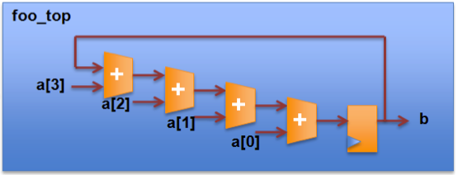
Optimization I: Loop unrolling
Exploits loop iteration parallelism
  Instantiate resources for simultaneous execution
  Respects iteration dependencies
Standard HLS
HLS & Unrolling
foo_top
+
b
a[N]
Takes 4 Cycles
Takes 1 Cycles

Slide 27
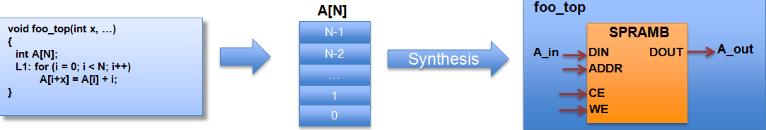
Optimization II: Array partitioning
HLS implements arrays as memory

Slide 28
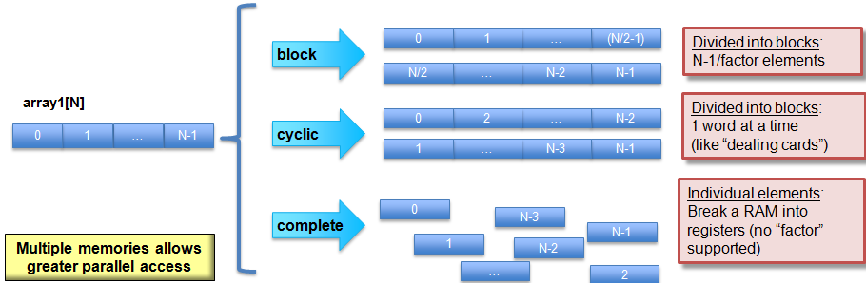
Optimization II: Array partitioning
Split arrays to improve memory bandwidth
Notes:
Complete brings the array into the data-path.
Replaces the memory with a bunch of local registers.

Slide 29
Optimization III: Resources
Allocation directive constrains resources
  Operations
    Number of adders instantiated RTL
Can save a lot of area

Slide 30
Optimization III: Resources
Specify implementation
  Tag operator
  Select core for thisMult
    a[i] = b[i] * c[i]
    thisMult = b[i] * c[i];
    a[i] = thisMul;

Slide 31
Optimization III: Resources
Specify implementation
  Tag operator
  Select core for thisMult
Core | Description
Mul | Combinational mult
Mul3s | 3-Stage pipelined mult
MulnS | HLS determine stages
    thisMult = b[i] * c[i];
    a[i] = thisMul;

Slide 32
Optimization IV: Loop pipelining
Loop_tag : for( II = 1 ; II < 3 ; II++ ) {
op_Read;
op_Compute;
op_Write;
}
RD
CMP
WR

Slide 33
Optimization IV: Loop pipelining
Without Pipelining
Loop_tag : for( II = 1 ; II < 3 ; II++ ) {
op_Read;
op_Compute;
op_Write;
}
RD
CMP
WR
RD
CMP
WR
RD
CMP
WR
Throughput = 3 cycles
Latency = 3 cycles
Loop Latency = 6 cycles
Notes:
Executes loops one after the other.

Slide 34
Optimization IV: Loop pipelining
Without Pipelining
With Pipelining
Loop_tag : for( II = 1 ; II < 3 ; II++ ) {
op_Read;
op_Compute;
op_Write;
}
RD
CMP
WR
RD
CMP
WR
RD
CMP
WR
RD
CMP
WR
RD
CMP
WR
Throughput = 3 cycles
Throughput = 1 cycle
Latency = 3 cycles
Latency = 3 cycles
Loop Latency = 6 cycles
Loop Latency = 4 cycles
Notes:
Reuses available hardware.

Slide 35
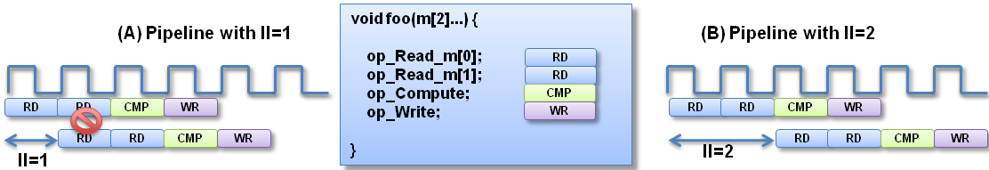
Optimization IV: Loop pipelining
Iteration Interval (II)
  Cycles loop must before next iteration
II = 1 cannot be implemented
  Port cannot be read at the same time
  Similar effect with other resource limitations

Slide 36
Exploring Design Space with directives

Slide 37
Quantitative design process

